Slide 1
EV Remote Internship Project Report
Created by
Bharath, Simulation Engineer
Project Name
Ather Energy 450
Case Studies: FTP-75/MENDC/WLTP Drive Cycle

Slide 2
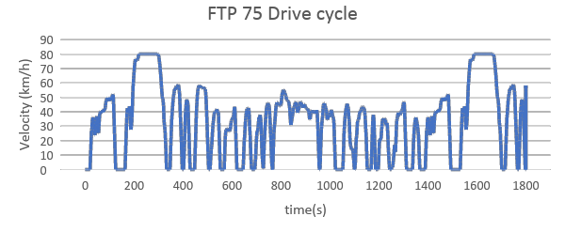
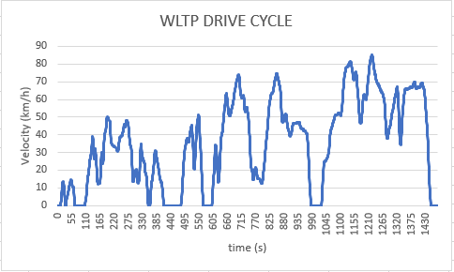
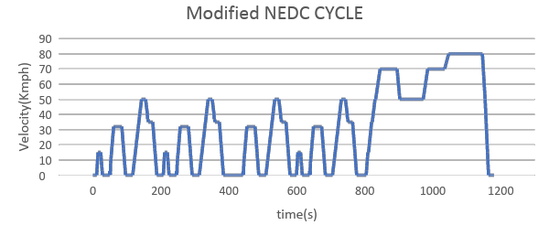
Drive Cycles
FTP-75 Drive Cycle
WLTP Drive Cycle
NEDC Drive Cycle
This Simulation was performed with respect to drive cycle
Distance
FTP-75 = 17.5 km
MNEDC = 10.274 km
WLTP = 14.664 km

Slide 3
Model Inputs
Sl No | Parameter | Value | Units
1 | Chassis
2 | Coefficient of rolling resistance | 0.015
3 | Mass of Vehicle | 111 | Kg
4 | Mass of Driver | 80 | Kg
5 | Gravity constant | 9.81 | m/s
6 | Grade Angle | 0 | degree
7 | Velocity | From the FTP Drive Cycle data | Kmph
8 | Area | 0.875 | m^2
9 | Air Density | 1.225 | Kg/m^3
10 | Drag Coefficient | 0.22
11 | Radius of wheel | 0.1524 | m
12 | Transmission
13 | Gear Ratio | 7.8
14 | Transmission Efficiency | 85 | %
15 | Motor
16 | Motor Efficiency | 90 | %
Sl No | Parameter | Value | Units
17 | Battery
18 | Motor Controller Efficiency | 85 | %
19 | Battery Capacity | 2400 | Wh
20 | Battery Voltage | 51.1 | V
21 | FTP drive cycle distance | 17.5 | Km
22 | Battery Initial SOC | 100 | %
23 | Drive Cycle time or Simulation time | 1875 | s
24 | Cell
25 | Cell Voltage | 3.6 | V
26 | Cell Capacity | 2.7 | Ah

Slide 4
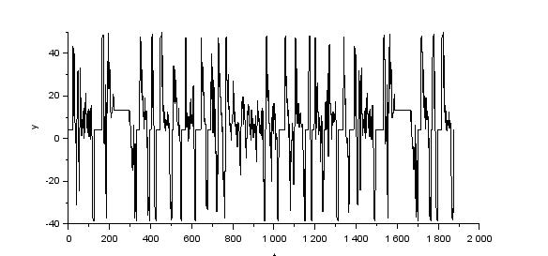
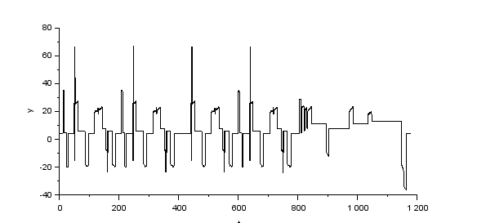
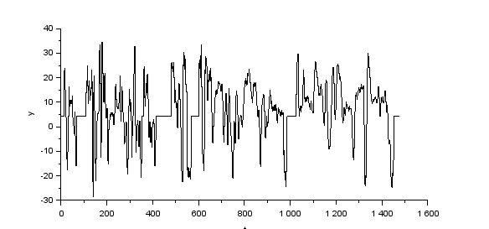
Wheel Torque for different Drive Cycles
FTP-75 Drive Cycle
MNEDC Drive Cycle
WLTP Drive Cycle
Nominal Torque = 50 | Nominal Torque = 70 | Nominal Torque = 35
Average Nominal Torque = 35 to 70 Nm

Slide 5
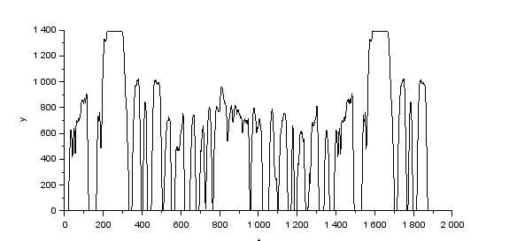
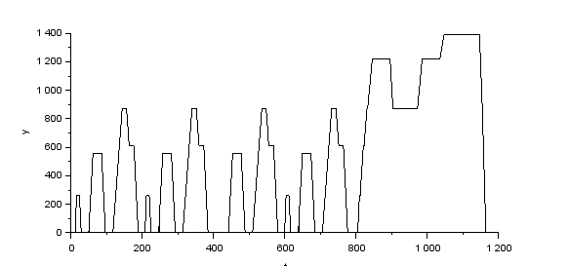
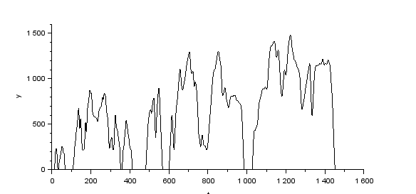
Wheel Speed for different Drive Cycles
FTP-75 Drive Cycle
MNEDC Drive Cycle
WLTP Drive Cycle
Wheel Speed = 1400 | Wheel Speed = 1400 | Wheel Speed = 1500

Slide 6
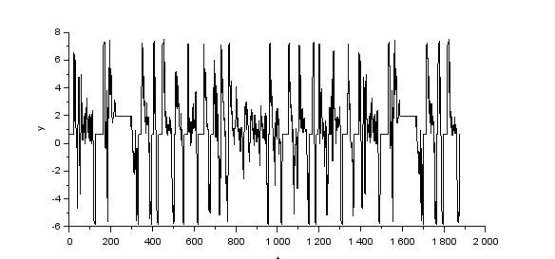

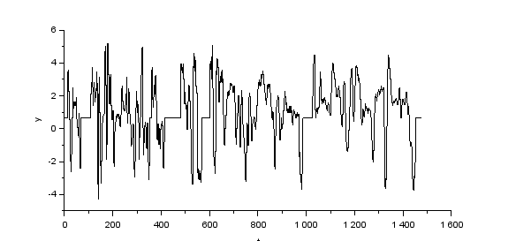
Motor Torque for different Drive Cycles
FTP-75 Drive Cycle
MNEDC Drive Cycle
WLTP Drive Cycle
Nominal Torque = 7.5 | Nominal Torque = 10 | Nominal Torque = 5
Average Nominal Torque = 5 to 10 Nm
Note: Maximum acceleration for the drive cycle is 2.15 m/s^2
Maximum Acceleration for the Acceleration Test is 5 m/s^2

Slide 7
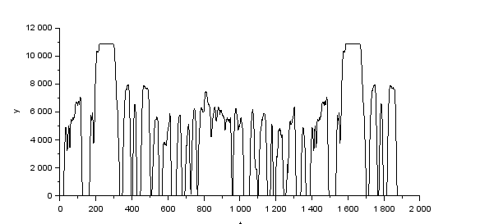
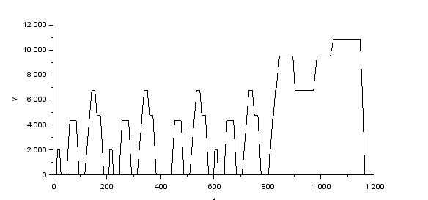
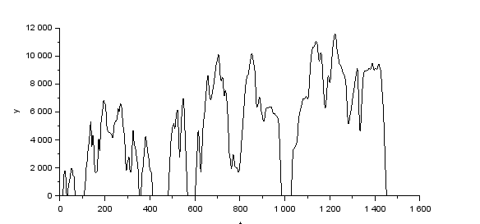
Motor Speed for different Drive Cycles
FTP-75 Drive Cycle
MNEDC Drive Cycle
WLTP Drive Cycle
Motor Speed = 11000 | Motor Speed = 11000 | Motor Speed = 11500
Motor Speed (for 80 kmph) = 11000 rpm

Slide 8
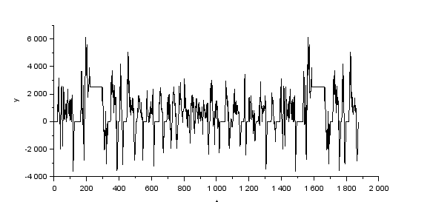
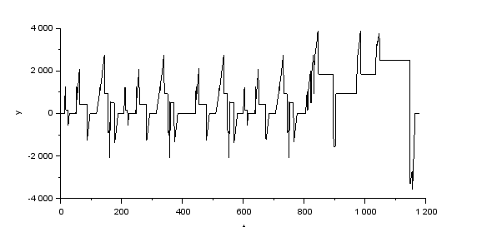
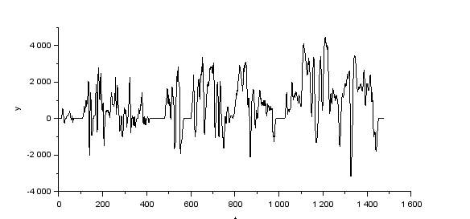
Motor Power for different Drive Cycles
FTP-75 Drive Cycle
MNEDC Drive Cycle
WLTP Drive Cycle
Nominal Power = 3000 | Nominal Power = 2700 | Nominal Power = 3300
Average Motor Nominal Power = 2700 to 3300 Watts

Slide 9
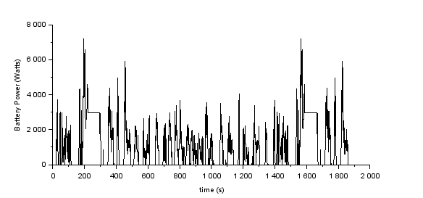
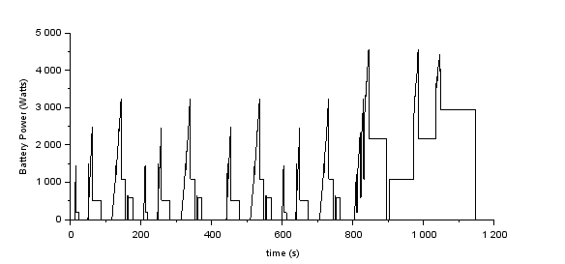
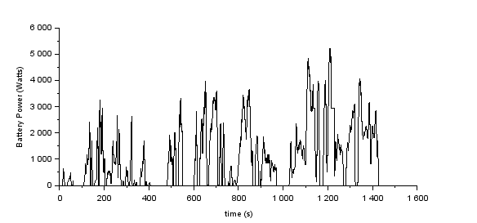
Battery Power for different Drive Cycles
FTP-75 Drive Cycle
MNEDC Drive Cycle
WLTP Drive Cycle
Nominal Power = 3800 | Nominal Power = 2600 | Nominal Power = 3500
Average Battery Nominal Power = 2400 to 3800 Watts

Slide 10
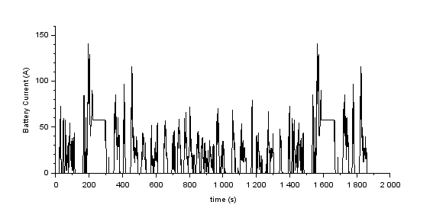
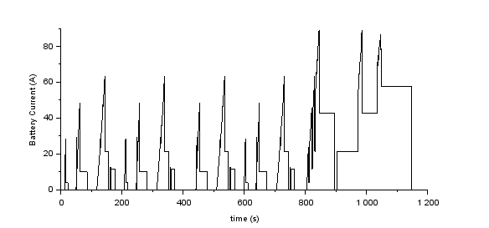
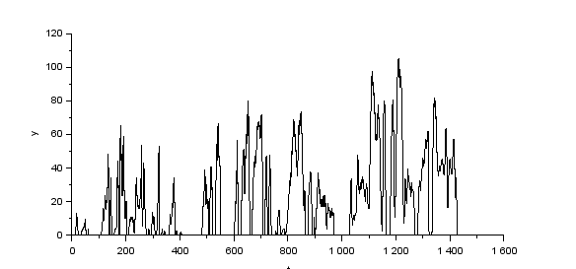
Battery Current for different Drive Cycles
FTP-75 Drive Cycle
MNEDC Drive Cycle
WLTP Drive Cycle
Nominal Current = 60 | Nominal Current = 50 | Nominal Current = 53
Average Battery Nominal Current = 50 to 60 A

Slide 11
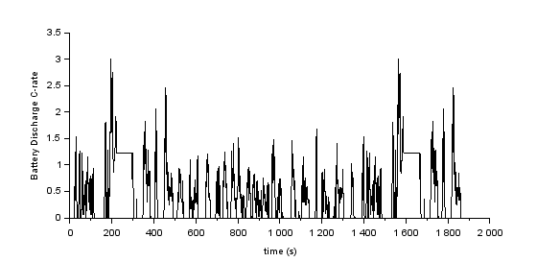
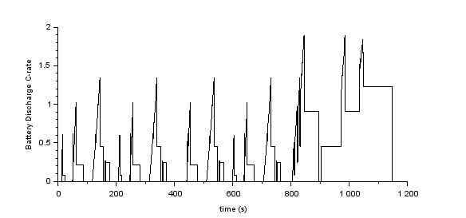
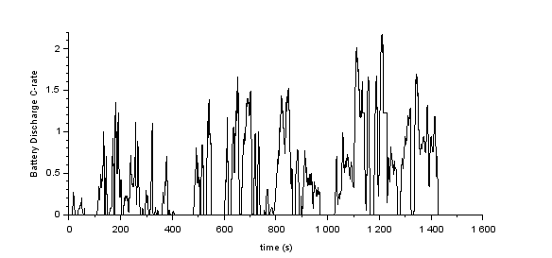
Battery Discharge C-rate for different Drive Cycles
FTP-75 Drive Cycle
MNEDC Drive Cycle
WLTP Drive Cycle
Nominal C-rate = 1.5 | Nominal C-rate = 1.1 | Nominal C-rate = 1.1
Average Battery Nominal C-rate = 1 to 1.5 C

Slide 12
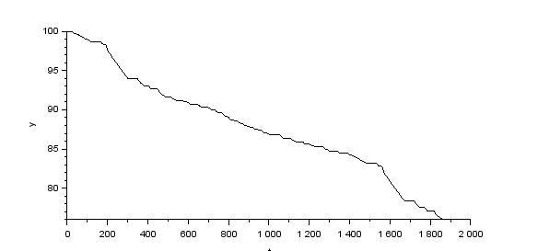
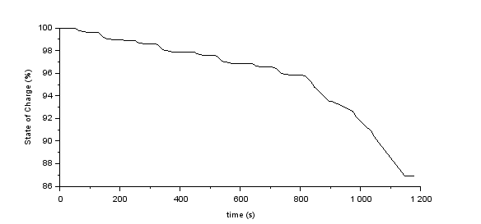
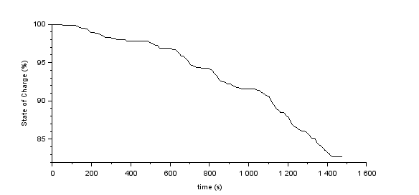
Battery SOC for different Drive Cycles
FTP-75 Drive Cycle
MNEDC Drive Cycle
WLTP Drive Cycle
SOC = 76 | SOC = 87 | SOC = 82
FTP Distance = 17.5 km | MNEDC Distance = 10.274 Km | WLTP Distance = 14.664 Km

Slide 13
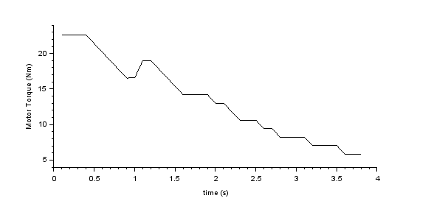
Acceleration Test
Motor Torque = 22.5 Nm

Slide 14
Range for different Drive Cycles
FTP 75 | MNEDC | WLTP
75 Km | 76.4 Km | 84.8 Km

Slide 15
Thank you
Email-id :
Mobile no.:

